Slide 1
UNIT 5
Prof. Somesh Nandi
Dept. of AIML
RV College of Engineering
Bengaluru

Slide 2
Outline
Software Objects:
Defining a Class, Defining Method, Instantiating an Object, invoking a Methods, Using Constructor, Using Class Attributes and Static Methods, Understanding Object Encapsulation
Object-Oriented Programming:
Using Inheritance to Create New Classes, creating a Base Class, inheriting from a Base Class, extending a Derived Class, Using the Derived Class, extending a Class through Inheritance, Understanding Polymorphism

Slide 3
Python Classes
A class is considered as a blueprint of objects.
Think of the class as a sketch (blueprint) of a house.
It contains all the details about the floors, doors, windows, etc. Based on these descriptions we build the house. House is the object.
Since many houses can be made from the same description, same way many objects can be created from a class

Slide 4
Define Python Class
We use the class keyword to create a class in Python. For example,
class ClassName:
# class definition
Here, we have created a class named ClassName.
Let's see an example,
class Bike:
name = ""
gear = 0
Here,
Bike - the name of the class
name/gear - variables inside the class with default values "" and 0 respectively.
Note: The variables inside a class are called attributes.

Slide 5
Python Objects and Instantiation of the Objects
An object is called an instance of a class.
For example, suppose Bike is a class then we can create objects like bike1, bike2, etc from the class.
Here's the syntax for object instantiation
objectName = ClassName()
Let's see an example,
# create class
class Bike:
name = ""
gear = 0
# Instate the objects of class
bike1 = Bike()
Here, bike1 is the object of the class. Now, we can use this object to access the class attributes.

Slide 6
Create Multiple Objects of Python Class
We can also create multiple objects from a single class.
For example,
# define a class
class Employee:
# define an attribute
employee_id = 0
# create two objects of the Employee class
employee1 = Employee()
employee2 = Employee()
# access attributes using employee1
employee1.employeeID = 1001
print(f"Employee ID: {employee1.employeeID}")
# access attributes using employee2
employee2.employeeID = 1002
print(f"Employee ID: {employee2.employeeID}")
In the above example, we have created two objects employee1 and employee2 of the Employee class.

Slide 7
Access Class Attributes Using Objects
The . Notation is used to access the attributes of a class.
Example :
# define a class
class Bike:
name = ""
gear = 0
# create object of class
bike1 = Bike()
# access attributes and assign new values
bike1.gear = 11
bike1.name = "Mountain Bike"
print(f"Name: {bike1.name}, Gears: {bike1.gear} ")

Slide 8
Python Methods
A Python Function defined inside a class is called a method.
#Let's see an example,
# create a class
class Room:
length = 0.0
breadth = 0.0
# method to calculate area (Function Defined Inside the Class)
def calculate_area(self):
print("Area of Room =", self.length * self.breadth)
# create object of Room class
study_room = Room()
# assign values to all the attributes *Self parameter is the reference to the current instance of the class and used
to access the variables of the class.
study_room.length = 42.5
study_room.breadth = 30.8
# access method inside class
study_room.calculate_area()

Slide 9
Invoking a Methods
The . Notation is used to Invoke the method
In the pervious example, we have created a class named Room with
Attributes: length and breadth and Method: calculate_area() and object named study_room
Now we have used the object to call the method inside the class,
study_room.calculate_area()
We have used the . notation to call the method.
Finally, the statement inside the method is executed.

Slide 10
Constructor in Python
A constructor is a special method in a class used to create and initialize an object of a class.
Constructor is invoked automatically when an object of a class is created.
Syntax of Python Constructor
def __init__(self):
# initializations
init is one of the reserved functions in Python. In Object Oriented Programming, it is known as a constructor.
Rules of Python Constructor
It starts with the def keyword, like all other functions in Python.
It is followed by the word init, which is prefixed and suffixed with double underscores with a pair of brackets, i.e., __init__().
It takes an argument called self, assigning values to the variables

Slide 11
Invoking Default Constructor in Python
When you do not write the constructor in the class created, Python itself creates a constructor during the compilation of the program.
It generates an empty constructor that has no code in it. Let's see an example:
class Assignments:
check= "not done"
# a method
def is_done(self):
print(self.check)
# creating an object of the class
obj = Assignments()
# calling the instance method using the object obj
obj.is_done()

Slide 12
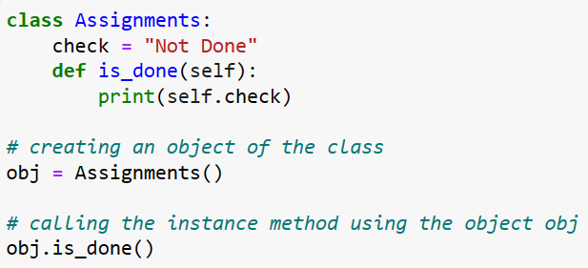
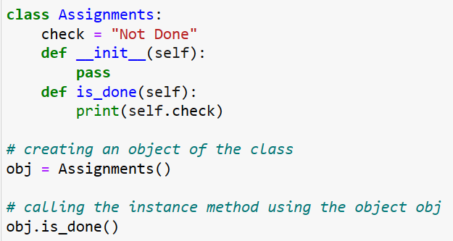
Invoking Method by Default Constructor in Python
When you do not write the constructor in the class created, Python itself creates a constructor during the compilation of the program.
It generates an empty constructor that has no code in it. Let's see an example, below, in both the output is” Not Done”
.

Slide 13
Invoking Method by Parameterized Constructor in Python
When the constructor accepts arguments along with self, it is known as parameterized constructor.
These arguments can be used inside the class to assign the values to the data members. Let's see an example:
Code:
class Family:
# Constructor - parameterized
members=‘’
def __init__(self, count):
print("This is parametrized constructor")
self.members = count
def show(self):
print("No. of members is", self.members)
object = Family(10)
object.show()
Explanation
An object of the class Family is created. It has a variable known as members.
When the object is created, a parameter (here it is 10) is passed as arguments.
This parameter (10 as in the given example) is taken up by the constructor as the object is created.
The number 10 is assigned to the variable count, which is further assigned to self.members.
The self.members can be used within the class to print the data

Slide 14
Methods in Python
There are two types of the Method in Python.
Class Method
The purpose of the class methods is to set or get the details (status) of the class. That is why they are known as class methods.
They can’t access or modify specific instance data. They are bound to the class instead of their objects. Two important things about class methods:
In order to define a class method, you have to specify that it is a class method with the help of the @classmethod decorator
Class methods take one default parameter- cls

Slide 15
Methods in Python
class My_class:
@classmethod
def class_method(cls):
return "This is a class method."
we’ll create the instance of this My_class as well and try calling this class_method():
obj = My_class()
obj.class_method()
class Methods In Python
We can access the class methods with the help of a class instance/object.
we can also access the class methods directly without creating an instance or object of the class.
Class_name.Method_name().
i.e My_class.class_method()

Slide 16
Methods in Python
A static method is bound to a class rather than the objects for that class. This means that a static method can be called without an object for that class. This also means that static methods cannot modify the state of an object as they are not bound to it
In order to define a static method, we can use the @staticmethod decorator
Example:
class Calculator:
# create addNumbers static method
@staticmethod
def addNumbers(x, y):
return x + y
print('Product:', Calculator.addNumbers(15, 110))
When we need some functionality not w.r.t an Object but w.r.t the complete class, we make a method static. This is pretty much advantageous when we need to create Utility methods as they aren’t tied to an object lifecycle usually

Slide 17
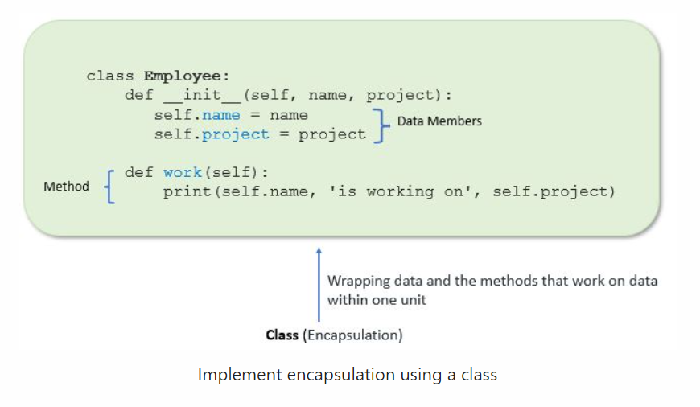
Encapsulation in Python
Encapsulation in Python describes the concept of bundling data and methods within a single unit.
Example
when you create a class, it means you are implementing encapsulation. A class is an example of encapsulation as it binds all the data members (instance variables) and methods into a single unit

Slide 18
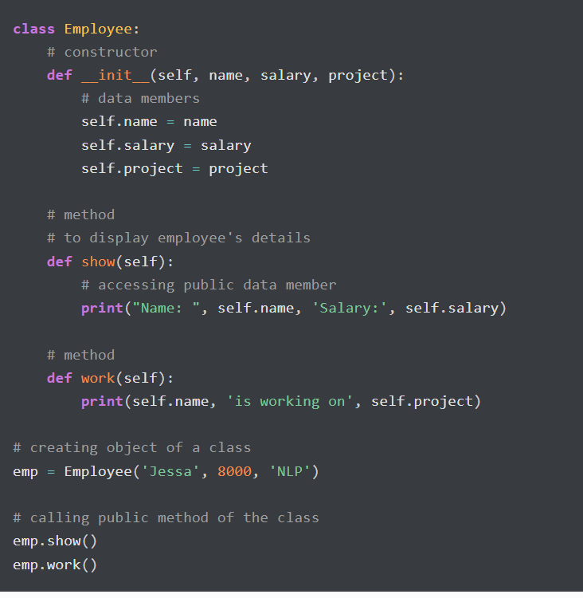
Encapsulation Example
In this example, we create an Employee class by defining employee attributes such as name and salary as an instance variable and implementing behavior using work() and show() instance methods.

Slide 19
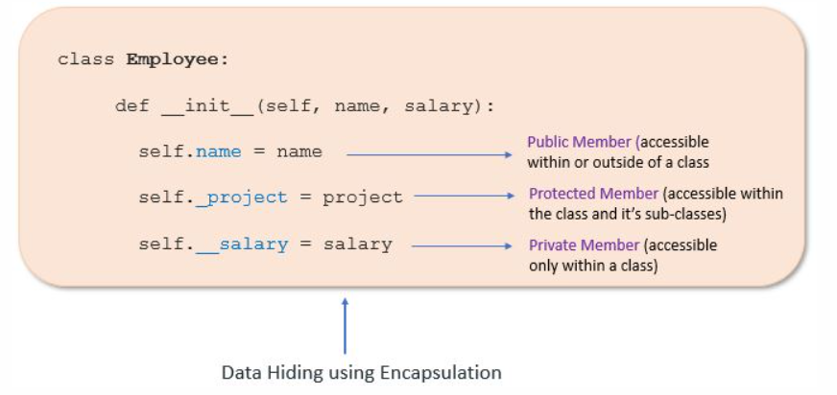
Access Modifiers in Python
Encapsulation can be achieved by declaring the data members and methods of a class either as private or protected.
This can be achieved by using single underscore and double underscores.
Access modifiers limit access to the variables and methods of a class.
Python provides three types of access modifiers private, public, and protected.
Public Member: Accessible anywhere from outside class.
Private Member(__): Accessible within the class
Protected Member(_): Accessible within the class
and its sub-classes

Slide 20
Public Member
Public data members are accessible within and outside of a class. All member variables of the class are by default public.
class Employee:
# constructor
def __init__(self, name, salary):
# public data members
self.name = name
self.salary = salary
# public instance methods
def show(self):
# accessing public data member
print("Name: ", self.name, 'Salary:', self.salary)
# creating object of a class
emp = Employee('Jessa', 10000)
# accessing public data members
print("Name: ", emp.name, 'Salary:', emp.salary)
# calling public method of the class
emp.show()

Slide 21
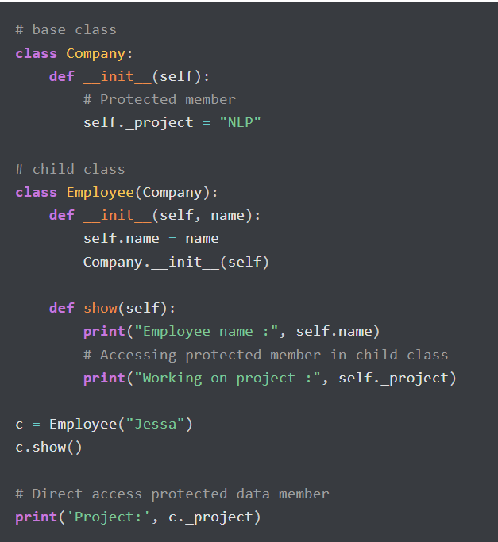
Protected Member
Protected members are accessible within the class and also available to its sub-classes. To define a protected member, prefix the member name with a single underscore _.
Protected data members are used when you implement inheritance and want to allow data members access to only child classes.
Example: Protected member in inheritance.

Slide 22
Private Member
To define a private variable add two underscores as a prefix at the start of a variable name.
Private members are accessible only within the class, and we can’t access them directly from the class objects.
class Employee:
# constructor
def __init__(self, name, salary):
# public data member
self.name = name
# private member
self.__salary = salary
# creating object of a class
emp = Employee('Jessa', 10000)
# accessing private data members
print('Salary:', emp.__salary)
When you Run The Code : The Error Occurs

Slide 23
Access Private Member
Access Private member outside of a class using an instance method.
class Employee:
# constructor
def __init__(self, name, salary):
# public data member
self.name = name
# private member
self.__salary = salary
# public instance methods
def show(self):
# private members are accessible from a class
print("Name: ", self.name, 'Salary:', self.__salary)
# creating object of a class
emp = Employee('Jessa', 10000)
# calling public method of the class
emp.show()

Slide 24
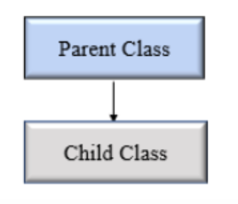
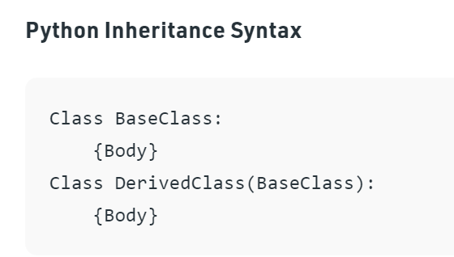
Using Inheritance to Create New Classes
Inheritance allows us to define a class that inherits all the methods and properties from another class.
Parent class is the class being inherited from, also called base class.
Child class is the class that inherits from another class, also called derived class.
Creating a Parent Class[Base Class]:
Any class can be a parent class, so the syntax is the same as creating any other class.
Syntax:
class Person def __init__(self, fname, lname): self.firstname = fname self.lastname = lname def printname(self): print(self.firstname, self.lastname) #Use the Person class to create an object, and then execute the printname method: x = Person("John", "Doe") x.printname()

Slide 25
Using Inheritance to Create New Classes
Creating a Child Class & Inheriting from a Base Class/Parent class:
To create a class that inherits the functionality from another class, send the parent class as a parameter when creating the child class.
Create a class named Student, which will inherit the properties and methods from the Person class.
Eg:
class Student(Person): pass
Note: Use the pass keyword when you do not want to add any other properties or methods to the class.
Now the Student class has the same properties and methods as the Person class.
Use the Student class to create an object, and then execute the printname method,this printname method was created in parent class.
x = Student(“varun", “sharma") x.printname()

Slide 26

Using Inheritance to Create New Classes
Creating a Child Class & Inheriting from a Base Class/Parent class:
Eg:
Code : Output:
class Person: def __init__(self, fname, lname): self.firstname = fname self.lastname = lname def printname(self): print(self.firstname, self.lastname)
class Student(Person): Pass
x = Student("Varun","Sharma")
x.printname()

Slide 27

Using Inheritance to Create New Classes
Using the Derived[child] Class, extending a parent Class through Inheritance:
Extending a Derived Class method:
Code : Output:
# Base class
class Vehicle:
def Vehicle_info(self):
print('Inside Vehicle class')
# Child class
class Car(Vehicle):
def car_info(self):
print('Inside Car class')
# Create object of Car
car = Car()
# access Vehicle's info using car object
car.Vehicle_info()
car.car_info()

Slide 28
Polymorphism
It refers to the use of a single type entity (method, operator or object) to represent different types in different scenarios
Example
For integer data types, + operator is used to perform arithmetic addition operation, Similarly, for string data types, + operator is used to perform concatenation.
num1 = 1
num2 = 2
print(num1+num2)
str1 = "Python"
str2 = "Programming"
print(“str1”+”str2”)

Slide 29
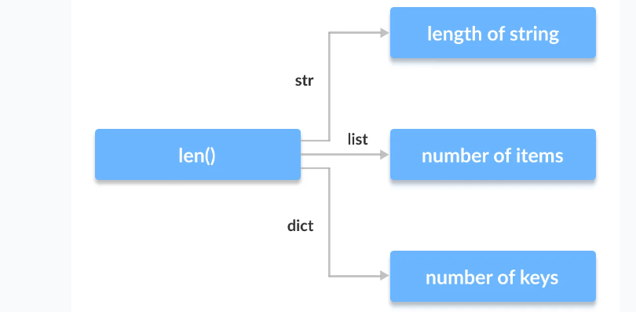
Function Polymorphism in Python
There are some functions in Python which are compatible to run with multiple data types.
One such function is the len() function. It can run with many data types in Python. Let's look at some example use cases of the function.
Example
print(len("Programiz"))
print(len(["Python", "Java", "C"]))
print(len({"Name": "John", "Address": "Nepal"}))

Slide 30
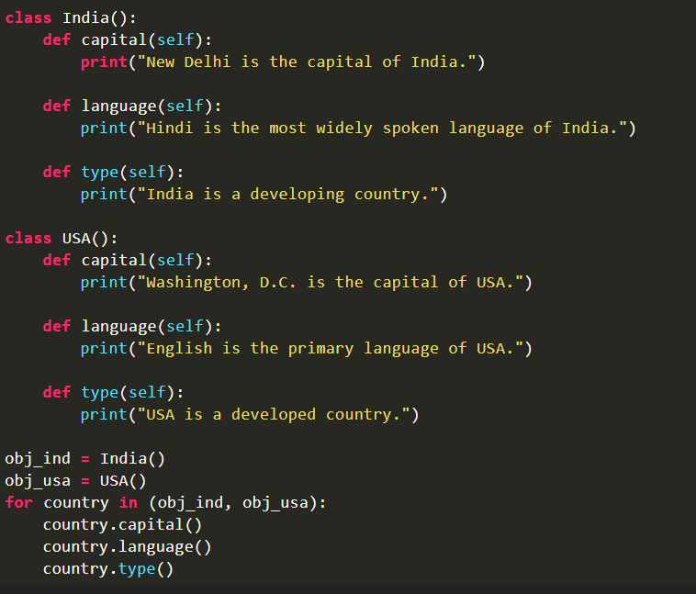
Class Polymorphism in Python
Polymorphism while creating class methods as Python allows different classes to have methods with the same name.
We can then later generalize calling these methods by disregarding the object we are working with.
Let's look at an example
We have created two classes India and USA.
They share a similar structure and have the same method names capital and language.
However, notice that we have not created a common superclass or linked the classes together in any way.
Even then, we can pack these two different objects into a tuple and iterate through it using a common country variable.
It is possible due to polymorphism.

Slide 31
Polymorphism with Inheritance
Polymorphism allows us to define methods in Python that are the same as methods in the parent classes.
In inheritance, the methods of the parent class are passed to the child class.
It is possible to change a method that a child class has inherited from its parent class.
This is especially useful when the method that was inherited from the parent doesn't fit the child's class.
We re-implement such methods in the child classes. This is Method Overriding.

Slide 32
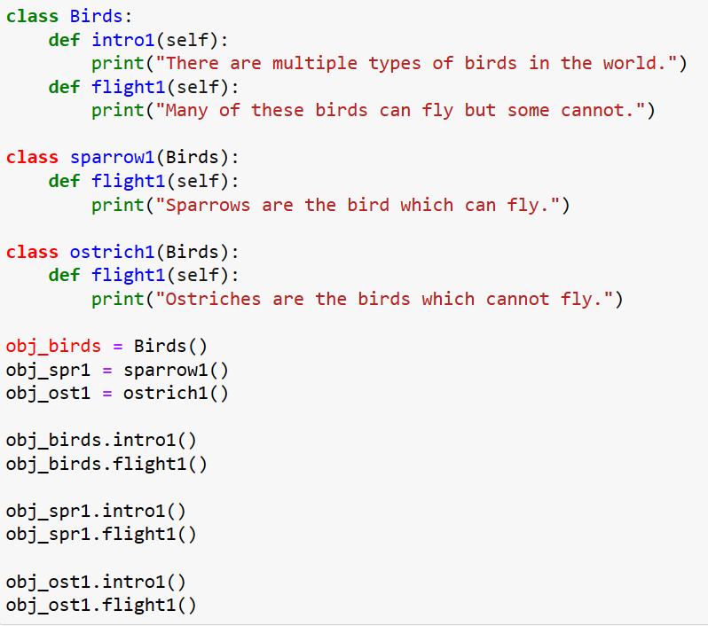
Polymorphism with Inheritance

Slide 33


